Slide 1
CENTRE for INDUSTRY
EDUCATION COLLABORATION
Sustainable ingredients:
Mixing ingredients

Slide 2

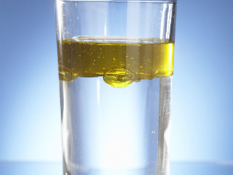
Scientists and engineers work together to design, test and make ingredients.
One ingredient made is called an emulsifier. It helps oil and water stay mixed for longer.
Scientists use emulsifiers in their products. New ones are researched so they are less harmful to the environment. They want the new products to be lighter (weigh less) and use less heat to make.
Notes:
Image 1: https://www.pexels.com/photo/engineers-looking-at-blueprint-3862135/
Image 2: Oil and water image taken from CIEC website - origin unknown

Slide 3

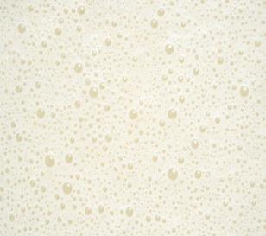
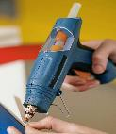

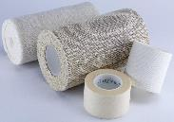
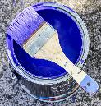
Company A
makes an ingredient called an emulsifier. It is used to help oil and water stay mixed together.
Company B
uses the emulsifier to make an important ingredient that can be used to make materials stretchy, strong, and bendy.
Company C
uses the important ingredient to make products like adhesives, waterproof coatings, tapes and paints.
Notes:
Image 1: https://pixabay.com/vectors/test-tube-liquid-blue-science-309204/
Image 2: AI created
Image 3 - compilation using:
https://www.pexels.com/photo/person-holding-a-blue-glue-gun-7508803/
https://pixabay.com/photos/iphone-ios-apple-6s-plus-white-1067991/
https://pixabay.com/photos/bandage-gauze-cure-2671511/
https://pixabay.com/photos/paint-brush-color-paint-brush-blue-1936787/

Slide 4
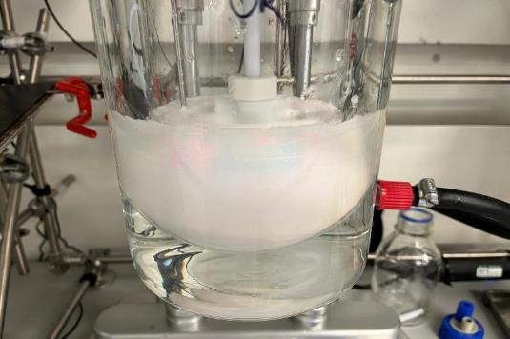
Here’s how Synthomer ingredients are stirred.
emulsified ingredients (creamy)
non-emulsified ingredients (clear)
Notes:
Image: provided by Synthomer - JPG requested

Slide 5
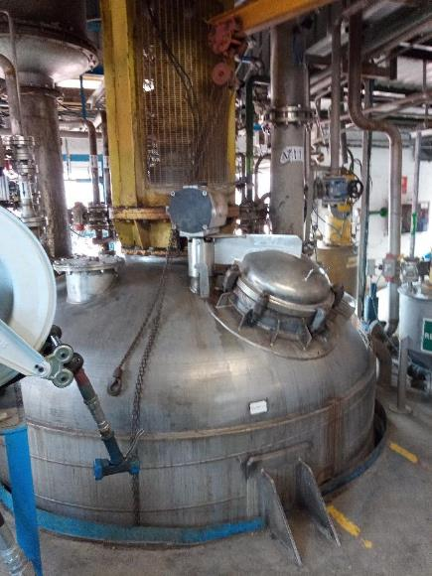
This is a reactor.
It works like a food mixer you might find in a kitchen, but on a much bigger scale.

Slide 6
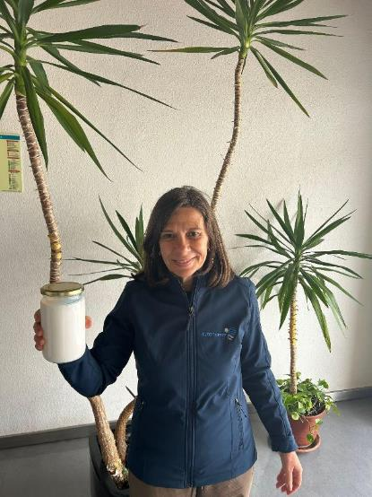
STEM Careers
This is Susana.
She is holding a jar of Synthomer’s important ingredient.
She works as a team with fellow scientists and other colleagues at Synthomer to develop ingredients that are more sustainable by being less harmful to the environment and safer for people.
Susana loves her job because she feels she is contributing to a better world.
Notes:
Image: JPG provided by Synthomer

Slide 7

www.ciec.org.uk

